Slide 1
Exploring Row-column Data
Data nerding
Lunch and Learn: Exploring row-column datasets with Python

Slide 2
Exploring Your Data
Eyeball your dataset
Get the basics statistics (mean, sd etc) of your data
Understand how data columns interact
Clean your data
Plot your data (visually look for trends and outliers)
Do more cleaning if you need to (e.g. those outliers)

Slide 3

RECAP: Python Basics
Or, ‘what we learned last time...’

Slide 4
Session 4 (Communicating Results) recap
Communicating with data
Really common visualisations
Quite common visualisations
Matplotlib
Tableau
D3 and beyond

Slide 5
Checking out a dataset in Pandas
Or, ‘Eyeballing…’

Slide 6
Reading CSV files with Pandas
import pandas as pd
df = pd.read_csv('technion_january.tsv', sep='\t')
Notes:
Beware: if you have more columns of data than you have column headings, Pandas read_csv can fail. If this happens, there are lots of optional parameters to read_csv that can help, but in practice it’s better to feed in clean data.

Slide 7
Eyeballing rows
How many rows are there in this dataset?
len(df)
What do my data rows look like?
df.head(5)
df.tail()
df[10:20]
Notes:
df.shape gives number of rows and columns

Slide 8
Eyeballing columns
What are my column names and types?
df.columns
df.dtypes
Which labels do I have in this column?
df['server'].value_counts()
What are my columns’ mean, standard deviation etc?
df.describe()
Notes:
NB df.describe will only find mean and SD for numerical columns - which is reasonable. df['server'].unique() will also return a list of labels in a column, but without the label counts.

Slide 9
Eyeballing individual columns
What’s in these columns?
df['server']
df[['type', 'outcome', 'server']]
Notes:
df[k].unique()
df.sort_values([‘row1id’, ‘row2id’])

Slide 10
Filtering by column values
Filtering by column values
df[df['server'] == 'DAVID']
df[df['server'] == 'DAVID'] [['type', 'outcome', 'server']]
df[(df['server'] == 'DAVID') & (df['type'] == 'TT')]
df[df['customer_id'] != 0]['server'].value_counts()
Notes:
If you want to look at a typical row for each server name, try
df.drop_duplicates(subset=['server']) [['type', 'outcome', 'server']]

Slide 11
Filtering on Text columns
dfphone = pd.DataFrame( [['a', 1, 'iphone 6s 16GB'], ['b', 2, 'iphone SE 16GB'], ['c', 1, 'iphone 6S 16GB'], ['a', 1, 'Samsung galaxy S7'], ['a', 2, 'hTC Desire 626s'], ['b', 2, 'HTC Desire 510']], columns=['store', 'quantity', 'model'])
dfphone[dfphone['model'].str.lower().str.contains('htc')]
 | store | quantity | model
0 | a | 1 | iphone 6s 16GB
1 | b | 2 | iphone SE 16GB
2 | c | 1 | iphone 6S 16GB
3 | a | 1 | Samsung galaxy S7
4 | a | 2 | hTC Desire 626s
5 | b | 2 | HTC Desire 510
Notes:
You need the “.str” to access the string part of each cell. .contains(astring) looks for a string in each cell; .lower() converts each string to lowercase.

Slide 12
Cleaning a dataset in Pandas
Or, ‘Eyeballing…’

Slide 13
Please Clean Your data!
Consistent format (e.g. text is all lowercase)
No whitespace hiding in number or text cells
No junk characters
Consistent labels (e.g. use M/F or Male/Female, not both)
Consistent timestamp formats
No strange outliers (e.g. 200 year old living people)
No junk rows or columns

Slide 14
Consistent Format, No whitespace
df2 = pd.DataFrame([['CApiTals Suck'], [' Spaces suck '], ['Spaces suck']], columns=['mytext'])
df2['mytext'].value_counts()
df2['mytext'] = df2['mytext'].str.lower() # lowercase
df2['mytext'] = df2['mytext'].str.strip() # remove spaces front and back of string
df2['mytext'].value_counts()
Notes:
Basic text cleaning
We'll spend a lot of time cleaning up text. Mostly this is because:
A) although you see 'Capital' and 'capital' as the same words, an algorithm will see these as different because of the capital letter in one of them
B) people leave a lot of invisible characters in their data (NB they do this to string representations of numerical data too - and many spreadsheet programs will store numbers as strings) - this is known as "whitespace", and can really mess up your day because "whitespace" and "whitespace " look the same to you, but an algorithm will see as different.
In the example, lower() converts a string into lowercase (upper() converts it into uppercase, but the convention in data science is to use all-lowercase, probably because it's less shouty to read), and strip() removes any whitespace before the first character, and after the last character (a-z etc) in the string.
NB if you want to lowercase and strip a string in the same command, use df2['mytext'].str.lower().str.strip()

Slide 15
Cleaning out junk characters
df2 = pd.DataFrame([['this is a string'], ['this is a string'], ['This is a! string&& with junk!@']], columns=['mytext'])
df2['mytext'].str.replace('\s', '+') # Replace each space
df2['mytext'].str.replace('\s+', '+') # Replace each set of spaces
df2['mytext'].str.replace('[^\w]', '') # Remove all non-alphabet characters
df2['mytext'].str.replace('[^\w ]', '') # Remove all non-alphabet, non-space characters
Notes:
There are repeated spaces in “this is a string”
This uses the RE (regular expression) library to clean up strings. To use a regular expression (aka RegEx), you need to specify two patterns: one input pattern that will be applied repeatedly to the input text, and one output pattern that will be used in place of anything that matches the input pattern. Regular expressions can be very powerful and can take a while to learn, but here are a couple of patterns that you’ll probably find helpful at some point.
^\w = everything that isn’t a character or number.
[] = a group of possible characters, e.g. [^\w ] = alphanumeric plus space.
\s+,\s+ = one or more spaces followed by a comma then one or more spaces
All the things you can do with Pandas text columns: http://pandas.pydata.org/pandas-docs/stable/text.html
All those regular expression codes: https://docs.python.org/3/library/re.html

Slide 16
Adding and Removing columns
df['newcolumn'] = 'this is new'
df = df.drop('newcolumn', axis = 1)

Slide 17
Adding and Removing Rows
df = df.append(pd.DataFrame([['xx', 10, 10, 1, 'PS', 990501, '22:07:01', '22:07:07', 6, '22:07:07', '22:09:25', 138, 'HANG', '0:00:00', '0:00:00', 0, 'DAVID']], columns=df.columns))
df.tail(1)
df[df['vru+line'] == 'xx']
df = df[df['vru+line'] != 'xx'] # remove rows that match this filter

Slide 18
Cleaning datetimes
df['realdate'] = pd.to_datetime(df['date'], format='%y%m%d')
df['weeknumber'] = df['realdate'].dt.week
df['weekday'] = df['realdate'].dt.weekday
# A more complex datestring conversion…
df['realqstart'] = pd.to_datetime(df['date'].apply(str) + ' ' + df['q_start'], format='%y%m%d %H:%M:%S')
Notes:
European vs American? Name of month vs number? Python comes with a bunch of date reformatting libraries that can convert between these.
More about date formats in https://docs.python.org/3/library/datetime.html and http://pandas.pydata.org/pandas-docs/stable/api.html#datetimelike-properties (NB Monday= day 0, Sunday=day 6).
If you need them, the datetime library has some powerful date-handing libraries, e.g.
import datetime
date_string = “14/03/48"
datetime.datetime.strptime(date_string, ‘%m/%d/%y').strftime('%m/%d/%Y')
PS try pd.pivot_table(df[['weeknumber', 'weekday', 'date']], index=['weeknumber'], columns='weekday', aggfunc='count') to see the number of calls on each day.

Slide 19
Relationships between columns
Or, ‘pivots...’

Slide 20
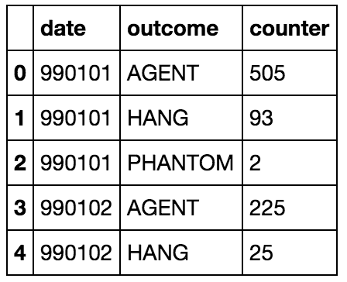
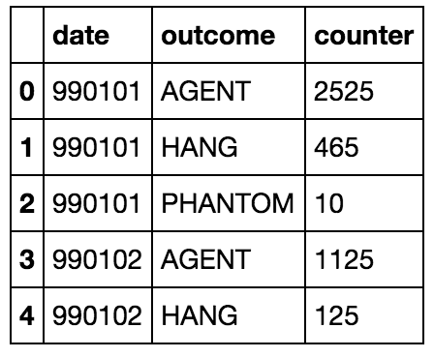
Counting combinations of column values
df['counter'] = 5
outcome_counts = df.groupby(['date', 'outcome'])['counter'].count().reset_index()
outcome_sums = df.groupby(['date', 'outcome'])['counter'].sum().reset_index()
Count
Sum
Notes:
There are three parts to a groupby call…
The list of columns whose combinations you want to look at (e.g. [‘date’, ‘outcome’]);
The column that you want to process (e.g. ‘counter’)
The processing that you want to do to that column (e.g. count(), sum(), mean() etc)
All other columns are ignored
Groupby produces a normalised output (every data point is on its own row), which is the type of input needed by visualisation software (e.g. Tableau) and machine learning algorithms.
Left image: dataframe created by pd.DataFrame. Right image: result of the groupby() call. This counts every unique *combination* of A and B values (you can do this for more than 2 columns too), e.g. there are 2 occurrances of (A=a, B=1) but only 1 occurrence of (A=a, b=2), and puts those counts into all the remaining columns. We’ve used [‘phone’] to select just the ‘phone’ column, .count() to return the number of times this combination occurs (things like .mean() are also available), and .reset_index() to convert this from group_by’s output format (which is a tree-like structure) back into a usable dataframe.

Slide 21
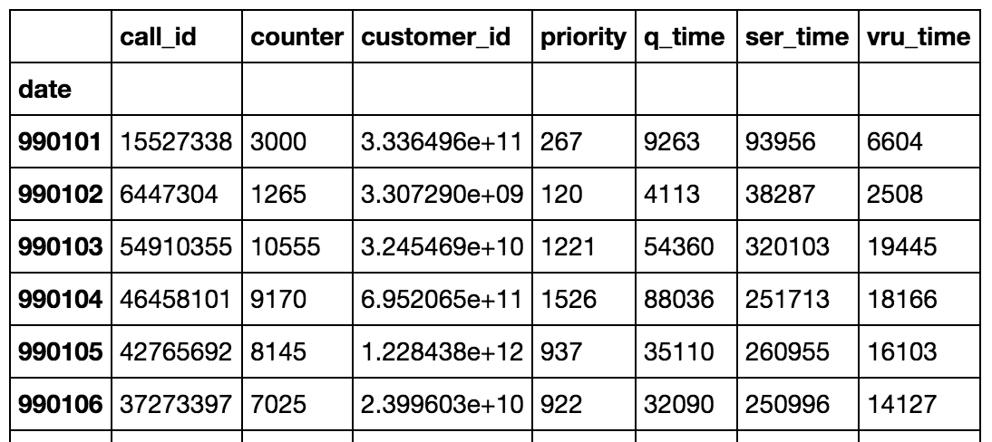
1-column PIVOT TABLE
import numpy as np
pd.pivot_table(df, index=['date'], aggfunc=np.sum)
Notes:
There are 4 parts to a pivot table:
The index, e.g. the column down the left side of the output (‘date’)
The column that you want to process (e.g. ‘outcome’). If this isn’t specified, the process is applied to every column value
The processing that you want to do to that column (e.g. count(), sum(), mean() etc)
Values will be shown for all other columns (along the top of the output)

Slide 22
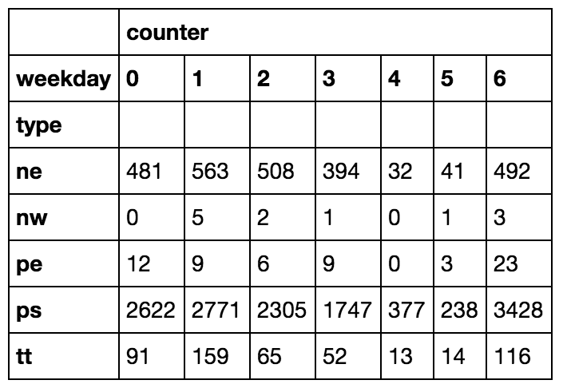
2-column Pivot table
pd.pivot_table(df[['weekday','type','counter']], index=['type'], columns='weekday', aggfunc='count', fill_value=0)
Notes:
<SJT: change out table for straight one>
There are 4 parts to a pivot table:
The index, e.g. the column down the left side of the output (‘date’)
The column that you want to process (e.g. ‘outcome’). If this isn’t specified, the process is applied to every column value
The processing that you want to do to that column (e.g. count(), sum(), mean() etc)
Values will be shown for all other columns (along the top of the output)
This is unnormalised, which means you can do things like plot columns against each other.
This is very similar to the pivot tables in Excel. Note the “aggfunc=np.sum”: this forces Pandas to give you the *sum* of data values (Pandas pivot_table defaults to giving you the mean of the data values in each column, np.mean). More at http://pbpython.com/pandas-pivot-table-explained.html
Those NaNs? “Not a number”, e.g. there was no data for the given combination of values (e.g. [indicator==‘Case fatality rate…’, country==‘Spain’]). Panda puts an NaN into every data cell that there’s no data for in the input dataset, e.g. when a CSV cell is blank (has no text or numbers).

Slide 23
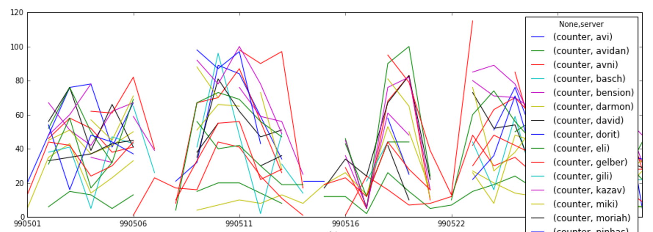
2-column pivot table + visualisation
import matplotlib.pyplot as plt
pt = pd.pivot_table(df[['date','server','counter']], index=['date'], columns='server', aggfunc='count')
pt.plot(figsize=(15, 5))
Notes:
You will need to:

Slide 24
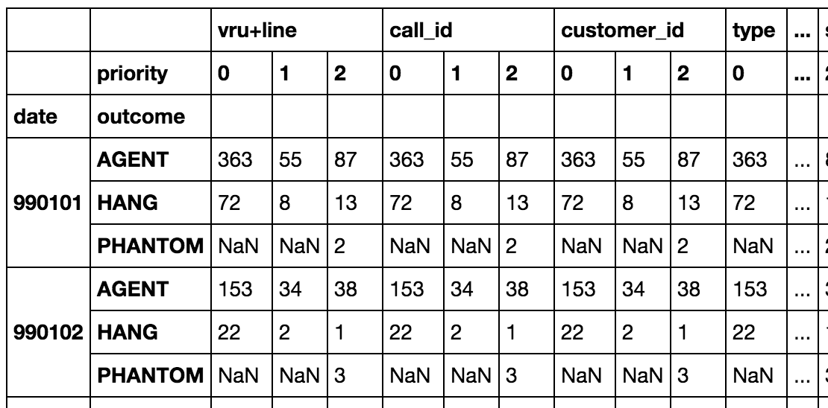
3-column Pivot Table
pd.pivot_table(df, index=['date', 'outcome'], columns='priority', aggfunc='count')

Slide 25
Combining dataSETS
Or, ‘What to do when you have more than 1 table...’

Slide 26
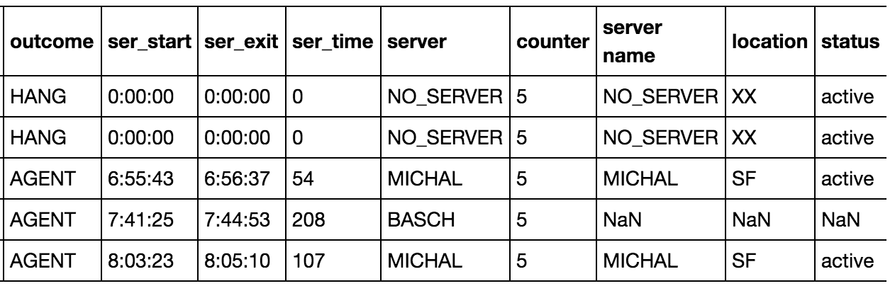
Merge: Combining data from multiple frames
dfserver = pd.read_csv('fakeserverdata.csv')
dfmerged = pd.merge(left=df, right=dfserver, left_on='server', right_on='server name', how= 'left')
Notes:
This is a left join, where pandas keeps every row from the ‘left’ table, and puts NaNs in the columns that don’t have any corresponding information in the ‘right’ table (this is what’s happened to BASCH, which isn’t in the dfservers table).
Pandas merge defaults to an ‘inner join’: only keep the rows where data exists in *both* tables.
See e.g. http://www.datacarpentry.org/python-ecology/04-merging-data
Left join: keep all rows from the first table; combine rows where you can, put “NaN”s in the rows when you can’t.
Some great visuals about joins: http://www.codeproject.com/Articles/33052/Visual-Representation-of-SQL-Joins

Slide 27
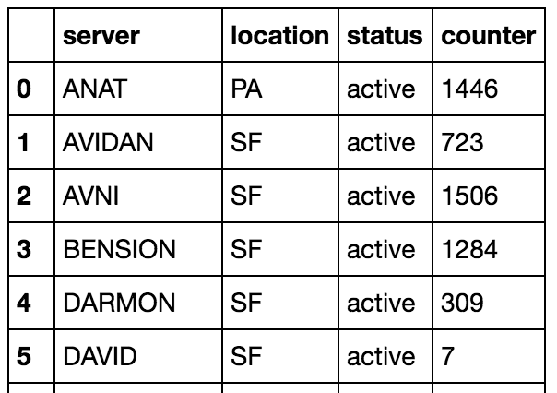
Checking your Join…
dfmerged.groupby(['server', 'location', 'status'])['counter'].count().reset_index()
Notes:
If you’re not if your join worked, you can check it: you’ve already got a function (groupby) that shows you all the available combinations of a set of columns. Use it. If you see the same server name appear in different rows, you may have an issue that needs to be fixed.
NB BASCH is missing here too, because its location and status are NaNs. This is default behaviour for Pandas and R: to change it, you need to convert the NaNs to another value (e.g. -1) before doing the groupby, e.g.
dfmerged.replace(np.nan, -1).groupby(['server', 'location', 'status'])['counter'].count().reset_index()

Slide 28
SQL Joins
For two tables (‘left’ and ‘right’), and the same column (e.g. ‘customer_id’) in both tables, join types are:
Left join: keep everything in Left, use “NaN” if Right value doesn’t exist
Right join: keep everything in Right, use “NaN” if Left value doesn’t exist
Inner join: keep everything that’s in both Left and Right
Full join: keep everything that’s in Left or Right; use “NaN” if either Left or Right value doesn’t exist
Notes:
SQL (Structured Query Language) is the language used to access data held in relational databases. A relational database consists of “tables”: row-column datasets that are related to each other through ”keys”. For example, a database might contain a table ‘customers’ that includes customer_id, name, email address, telephone number etc, a table ‘products’ that includes product_id, product_name and a third table ‘sales’ that contains customer_id, product_id, start_date, balance. If you want to get the email addresses of all customers with a named product, you’ll have to combine data from each of these tables. This is where SQL join statements come in.
See also: http://www.sql-join.com

Slide 29
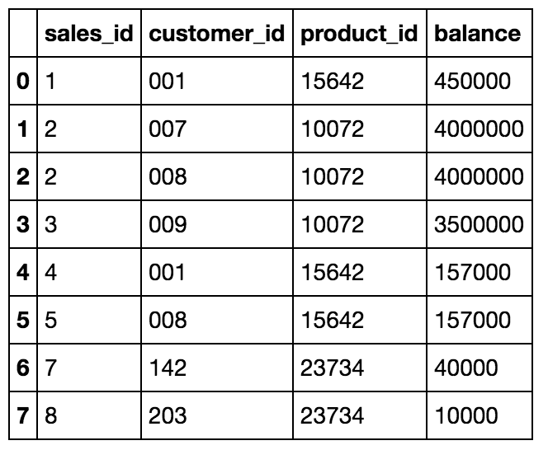
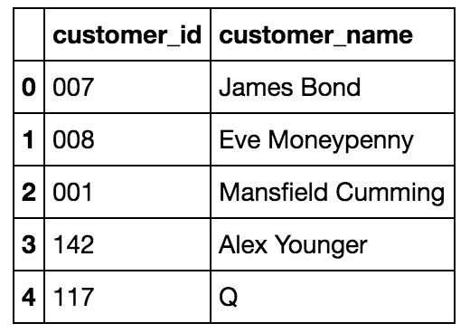
Example: MI6 Pensions…
Notes:
We have two tables, df_cust and df_sales, and we want to combine these. How we do this depends on what we’re trying to do with the dataset. Df_cust will be our Left table, df_sales will be our Right one.

Slide 30
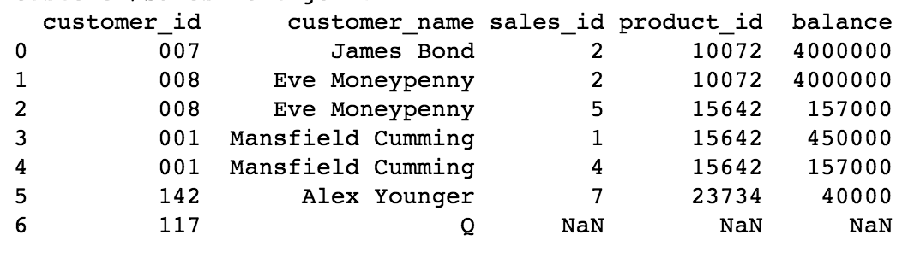
Left Join 0n CUSTOMER_ID
Notes:
Left join: keep every customer_id (and associated data) that’s in the Left table; put NaN if that customer_id isn’t in the Right table. Useful if you want to keep every row in the Left table, but want to use Right data values where they exist.

Slide 31
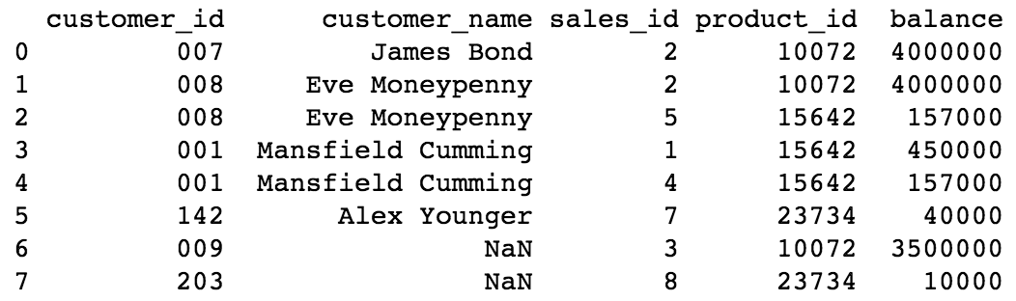
RIGHt Join 0n CUSTOMER_ID
Notes:
Right join: keep every customer_id (and associated data) that’s in the Right table; put NaN if that customer_id isn’t in the Left table. Useful if you want to keep every row in the Right table, but want to use Left data values where they exist.

Slide 32
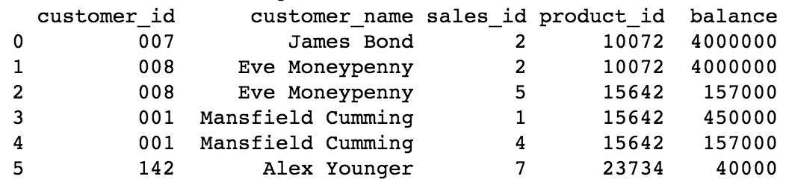
INNER Join 0n CUSTOMER_ID
Notes:
Inner: keep every customer_id that’s in *both* tables. Useful if you want to keep only the data that’s in both Left and Right tables.

Slide 33
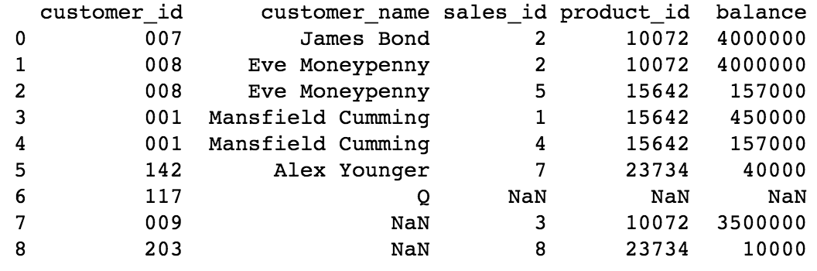
OUTER Join
Notes:
Outer join: keep every customer id, regardless of which data table it’s from. Useful if you don’t want to lose any data.

Slide 34
PlottinG data
Or, ‘go look at your data...’

Slide 35
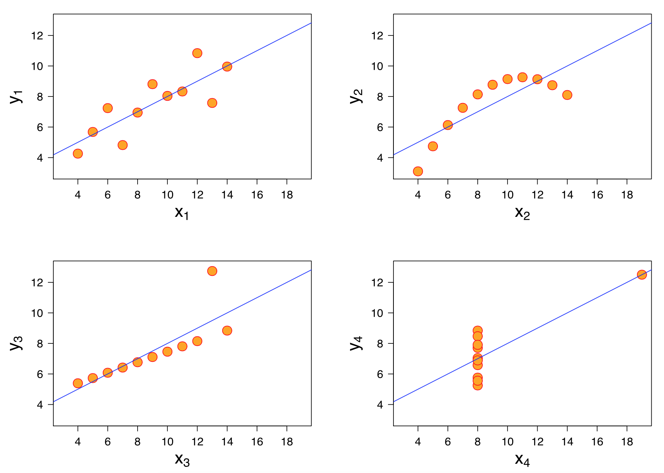
Why you should plot data…
Notes:
This is Anscombe’s quartet. Statistics for these 4 diagrams are the same, even thought they tell different stories: x mean is 9, x variance is 11, y mean is 7.50, y variance is 4.122, x to y correlation 0.816, linear regression line is the same (y = 3 + 0.5x).
More: https://en.wikipedia.org/wiki/Anscombe%27s_quartet
Image: wikipedia.

Slide 36
draw a line chart in Matplotlib
%matplotlib inline
import matplotlib.pyplot as plt
import numpy as np
x = np.linspace(0, 10, 100)
y = np.sin(x)
plt.plot(x, y)
Notes:
NB: You only need the %matplotlib inline in an ipython notebook.

Slide 37
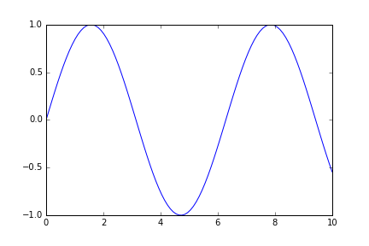
That line chart
Notes:
You can also apply this to dataframes, e.g. plt.plot(df['q_time'])

Slide 38
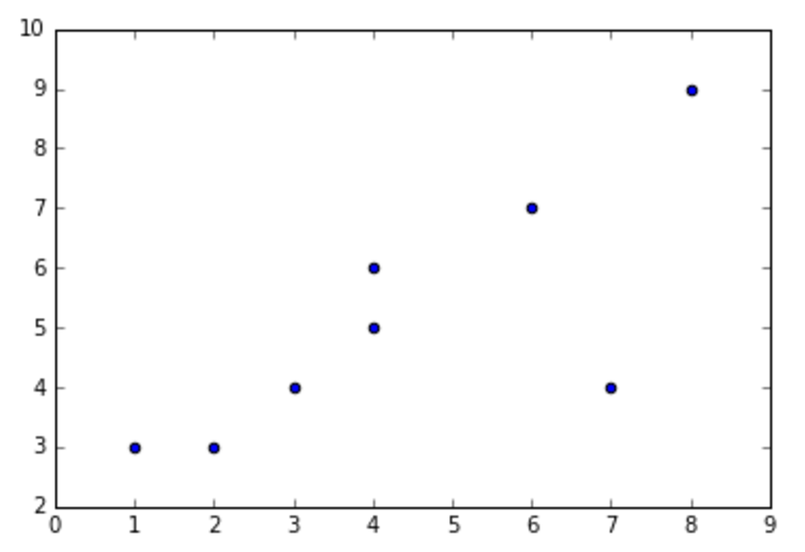
scatterplot
import matplotlib.pyplot as plt
import numpy as np
x = np.array([1,4,3,2,6,4,7,8])
y = np.array([3,5,4,3,7,6,4,9])
plt.scatter(x, y)
Notes:
Again, you can apply this to a dataframe, e.g. plt.scatter(df['q_time'], df['vru_time'])

Slide 39
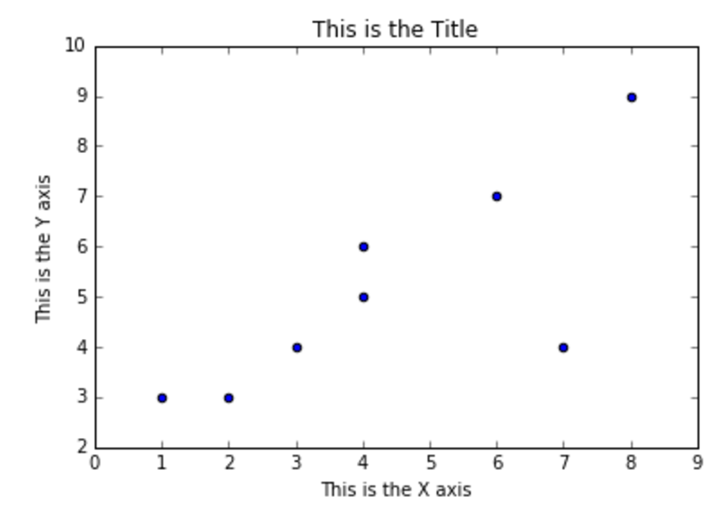
Add labels
fig, ax = plt.subplots()
plt.scatter(x, y)
ax.set_ylabel('This is the Y axis')
ax.set_xlabel('This is the X axis')
ax.set_title('This is the Title')
Notes:
plt.subplots creates a plot on your drawing ‘canvas’. It’s what we usually use to create a group of plots. Here, we’re using it to get at the axes (ax) for this visualisation.

Slide 40
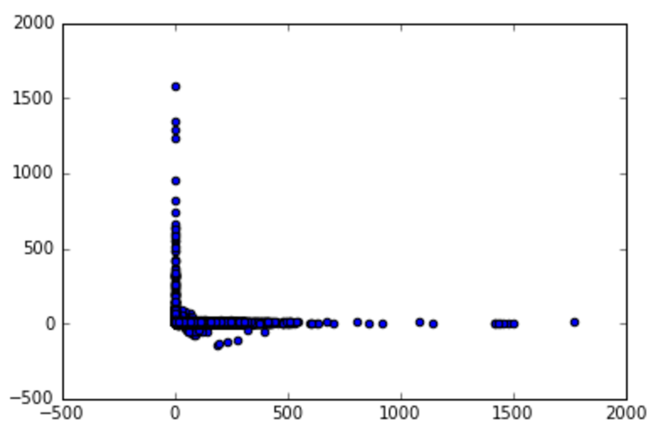
Scatterplot
plt.scatter(df['q_time'], df['vru_time'])

Slide 41
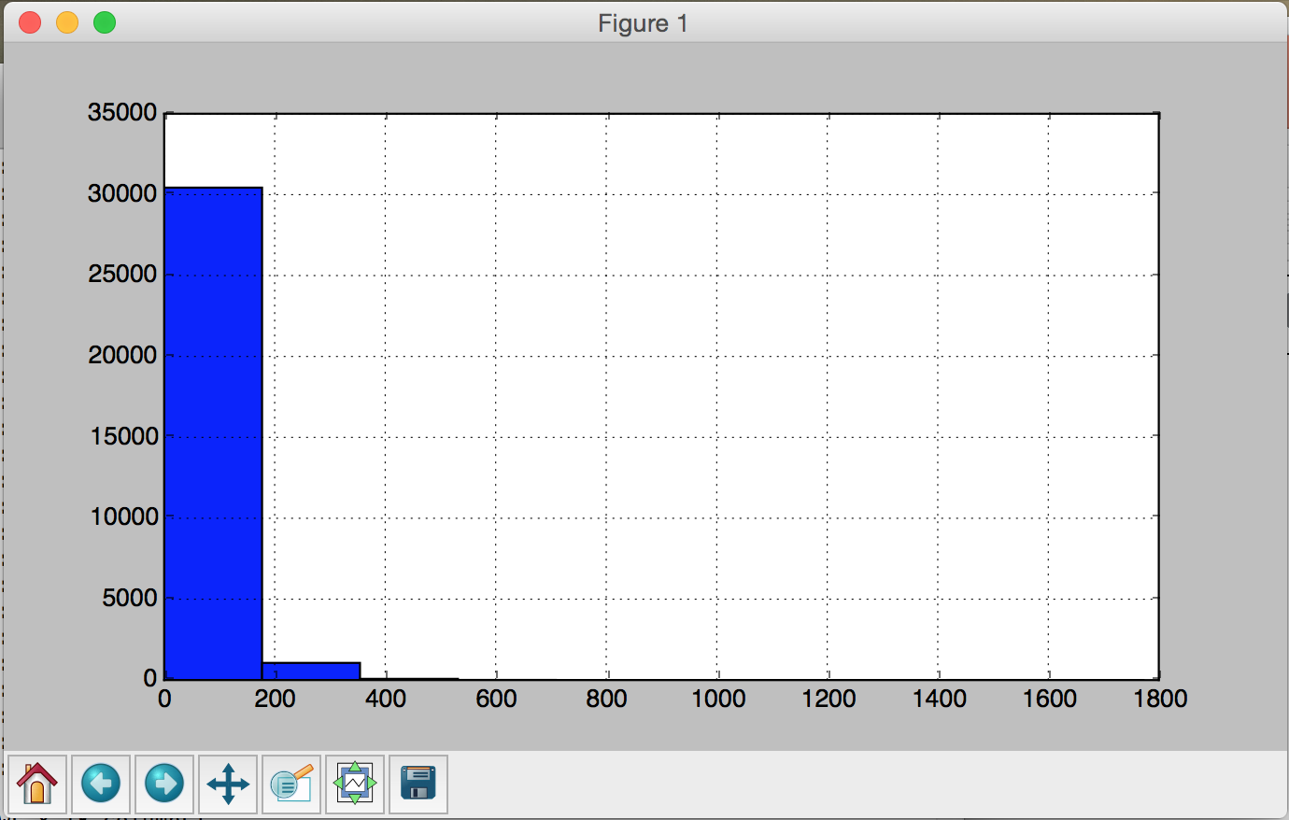
Histogram
import matplotlib.pyplot as plt
df['q_time'].hist()
plt.show()

Slide 42
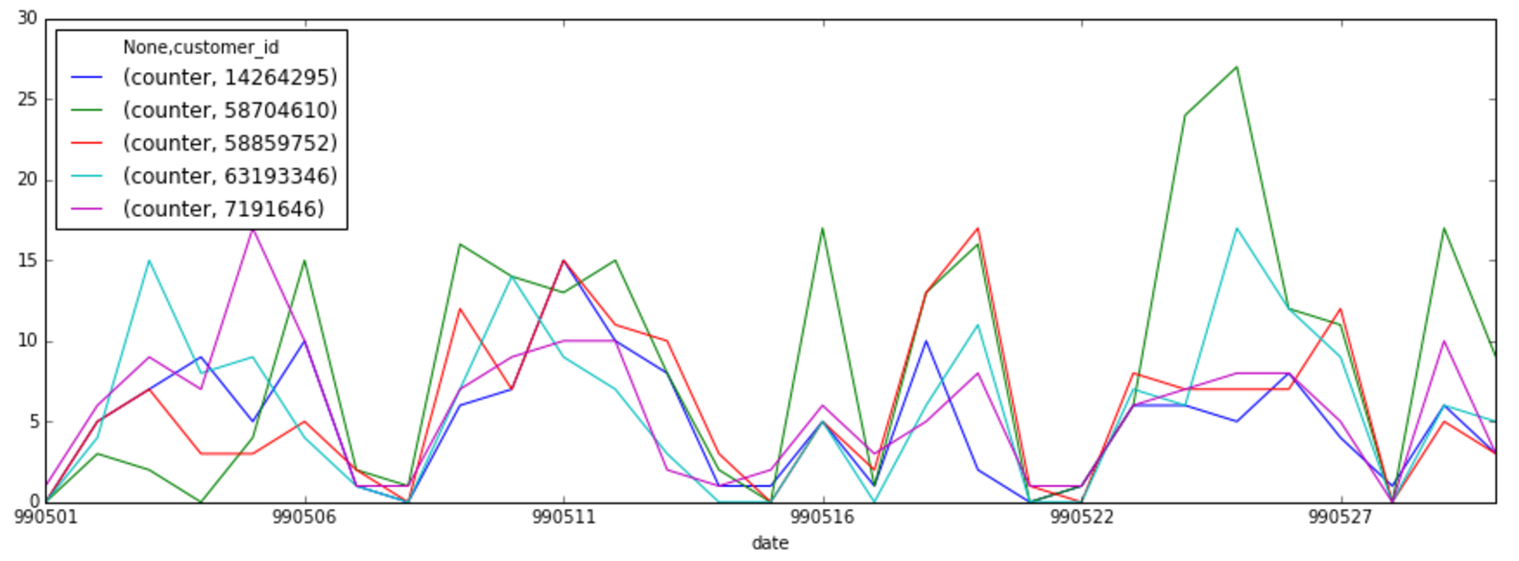
2-column Pivot + linechart
custidcounts = df['customer_id'].value_counts()
dftopcusts = df[df['customer_id'].isin(custidcounts.head(5).index)]
custpivot = pd.pivot_table(dftopcusts[['date','customer_id','counter']], index=['date'],
columns='customer_id', aggfunc='count', fill_value=0)
custpivot.plot(figsize=(15, 5))
Notes:
Visualisations can help with some more complex questions, like “these customers who call 250 times a month: what are they doing?”.
Here, we’ve used a pivot table to look at how many times each of the top 5 call each day.

Slide 43
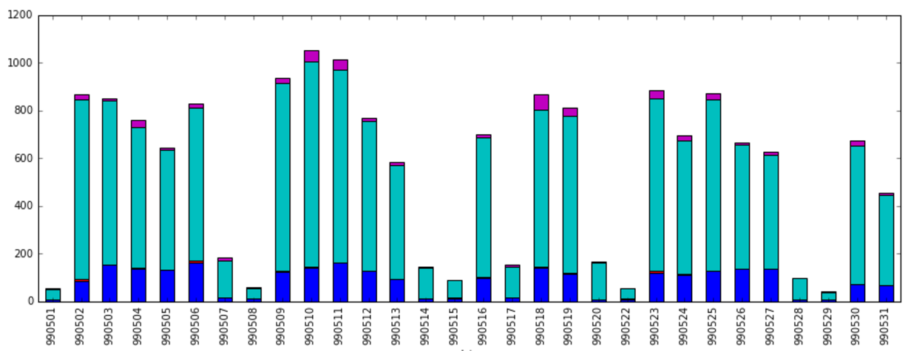
2-column pivot + Stacked Barchart
import matplotlib.pyplot as plt
pt_type = pd.pivot_table(df[['date','type','counter']], index=['date'],
columns='type', aggfunc='count', fill_value=0)
pt_type.plot.bar(figsize=(15, 5), legend=False, stacked=True)

Slide 44
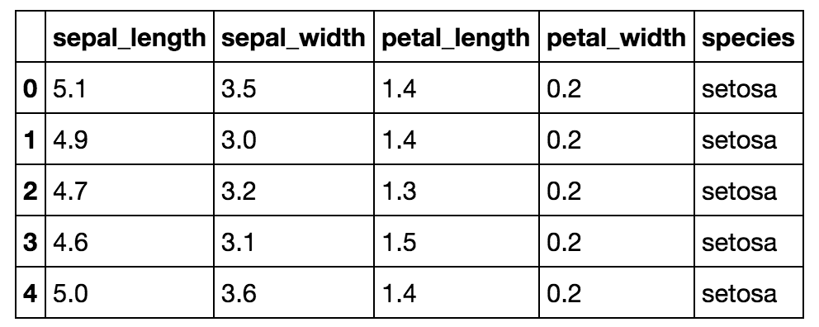
The Seaborn visualisation library
Import matplotlib.pyplot as plt
import seaborn as sns
iris = sns.load_dataset('iris')

Slide 45
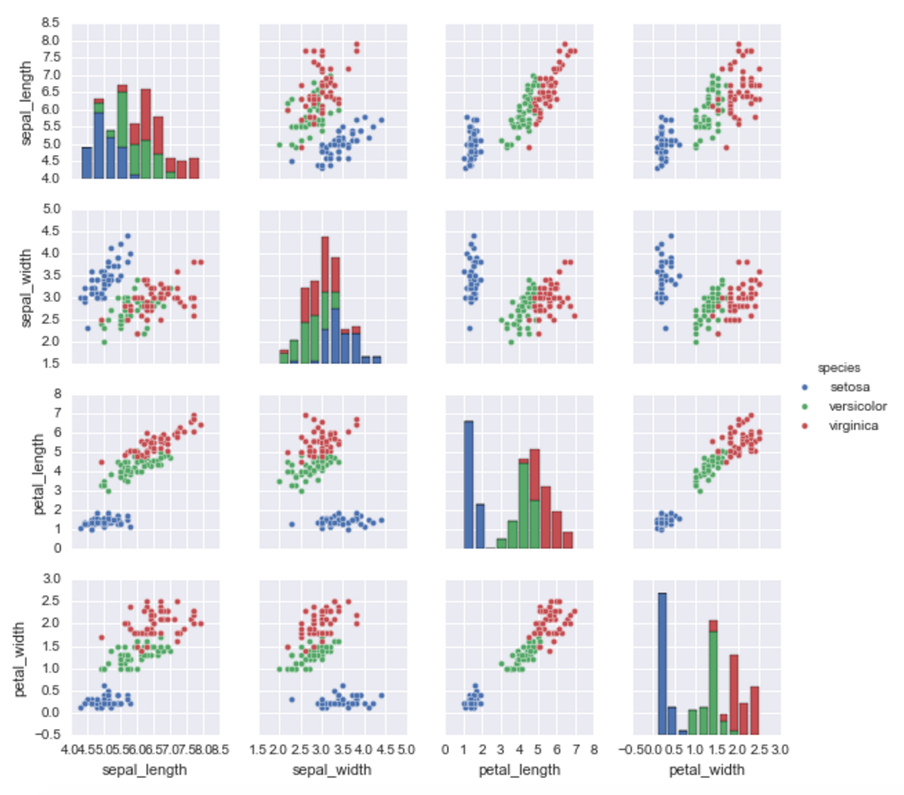
Visualising Iris data with Seaborn
sns.pairplot(iris, hue='species', size=2)
plt.show()
Notes:
You might want to do “sns.set()” before plotting…

Slide 46
RECAP: Exploring Row-Column data
Or, ‘what we learned last time...’

Slide 47
Exploring data
Data needs to be normalised, clean, consistent
Basic Pandas commands
Cleaning strings: .lower(), .strip(), regular expressions
Reshaping datasets
Visualising datasets with Matplotlib
Combining datasets

Slide 48
Learning More
Or, ‘what happens if…?’

Slide 49
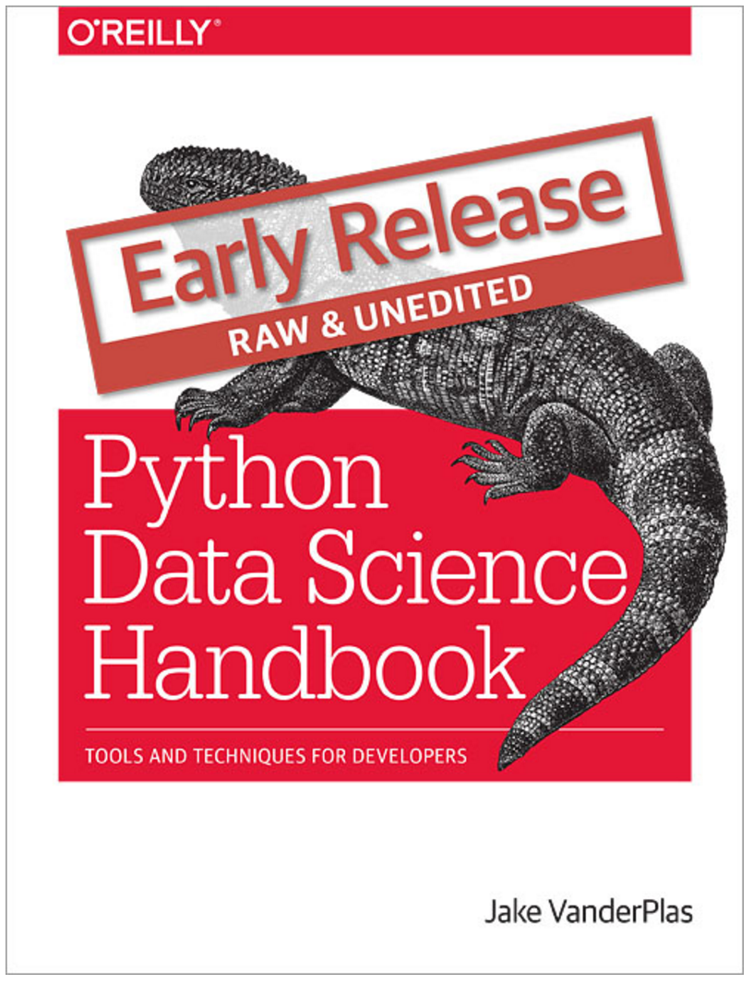
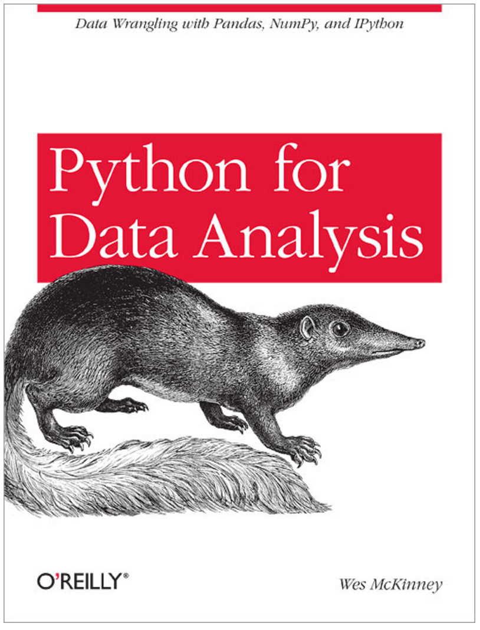
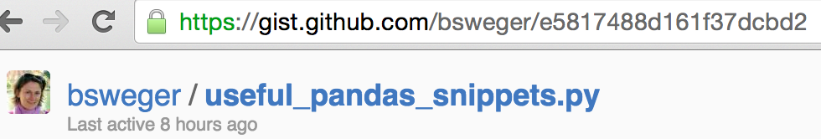
REading
“Outside of a dog, a book is a man’s best friend. Inside of a dog, it’s too dark to read” – Groucho Marx
Notes:
Deeper into Pandas:
● Becky Sweger, Pandas cheat sheet
● Chris Fonnesbeck, Introduction to Pandas
● Julia Evans, A Practical introduction to ipython notebook and pandas
● Jake Vanderplas, “ Python Data Science Handbook ”, O’Reilly (for (lots more) details).
● Manish Amde, Pandas and python: top 10
● $ Wes McKinney, “ Python for Data Analysis ” [a good introduction to libraries (Pandas, iPython etc) commonly used by Python-based
data scientists]

